Slide 1




Integrating Pre-Cooling of Data Center operated with Renewable Energies
2020 IEEE Cybermatics Congress – GreenCom
November 4th, 2020
Maël Madon – mael.madon@polytechnique.org
Jean-Marc Pierson – jean-marc.pierson@irit.fr
Notes:
Work close to the one presented by Maryline! Scheduling under energy prod.
Hello everyone, I’m Maël Madon, Master student from the Ecole Polytechnique in France and soon PhD student at IRIT Toulouse university.
Thank you for listening to the presentation of this paper that I jointly wrote with Professor Jean Marc Pierson and in which we try to investigate the potential of pre-cooling data centers as a mechanism to cope with renewable energy intermittency.

Slide 2
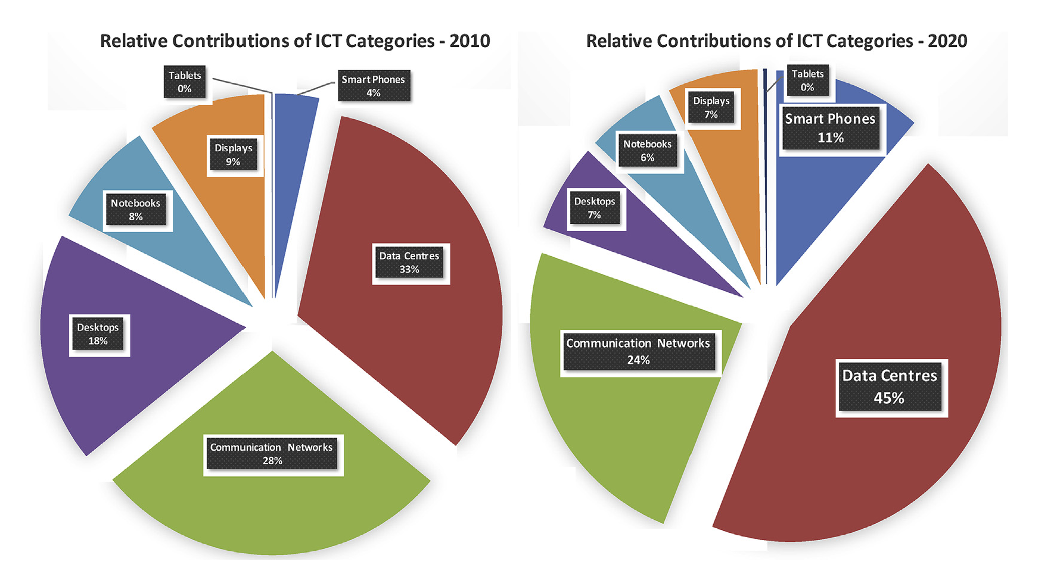
Environmental impact of IT
IT share of global greenhouse gas emissions: 1-3%
Source: Belkhir and Elmeligi, 2018
Notes:
Share of global GHG emissions: 1-3%, probably going to increase
Picture: Depict actual trend in the market and shift from desktops to small devices based on network infra and cloud

Slide 3

Data centers
GHG emissions from data centers: use phase most significative compared to other life cycle phases
Average PUE in 2020 = 1,58 (Uptime Institute, 2020)
$PUE= \frac{total electricity consumption of the DC}{electricity consumption of IT alone}$
Notes:
Use phase more significative: shift to renewables!
Power Usage Effectiveness.
1,58 means that more than one third is used for other (cooling, lightning, losses, monitoring…)
Our study does not try to lower the PUE but consume this extra energy at time where renewables are available.

Slide 4
Outline
Background of the study
Data center modelling
Pre-cooling simulation approach
Results and discussion

Slide 5
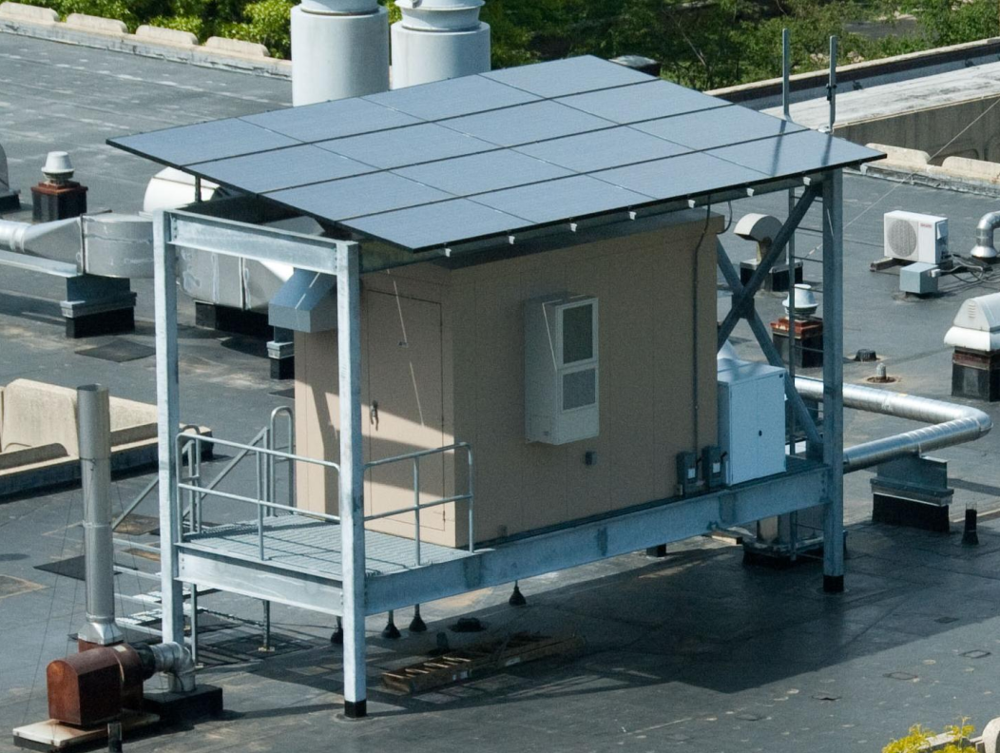
Self-consumption
(Goiri et al., 2013): Parasol et GreenSwitch
Notes:
Pioneer study in the field
Problem: intermittent sources
Joint management of workload and energy
Parasol: small container + solar panels + batteries

Slide 6
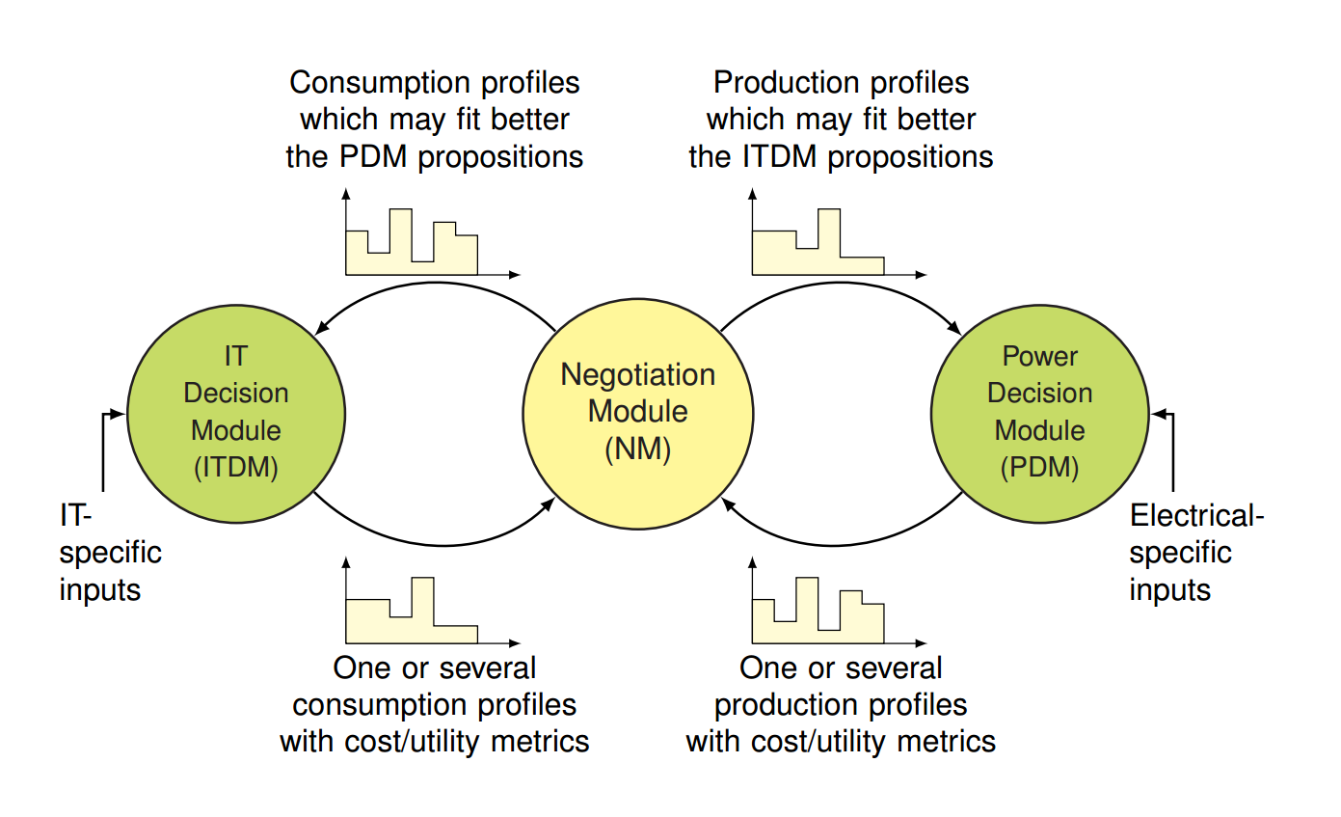
DataZero
Notes:
Other holistic approach: ANR project Datazero in which this work is part of
Modules that converge to a decision
In the same way as doing IT-load shifting, is it possible to make cooling-switching?

Slide 7
Precooling: related works
(Zhang et al., 2012) TEStore: Exploiting Thermal and Energy Storage to Cut the Electricity Bill for Datacenter Cooling
(Lukawski et al., 2019) Demand Response for Reducing Coincident Peak Loads
(Li et al., 2019) Thermal-Aware Hybrid Workload Management in a Green Datacenter towards Renewable Energy Utilization
Notes:
Not many related works
- TEStore: varying electricity price
- thermal tanks > backup batteries > precooling
- Peak loads:
- ”peak electricity pricing”: really expensive for 15 minutes 4 times in a year
- manage to swich of the cooling system during the peaks
- Li et al. : concurrent approach, only one dealing with renewables
- integrated into thermal aware workload and cooling management for renewables
=> No isolation and study of precooling alone in the literature => What we propose to do here

Slide 8
Description
Renewable energy powered data center cooled with geothermal heat pump
Small room (typical for telecom, small companies, computer rooms...)
Thermal model taken from (Lukawski et al., 2019)
Average IT load: 14 kW
Room area: 93 m²

Slide 9

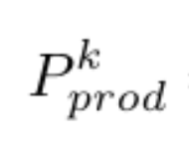

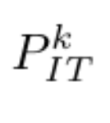
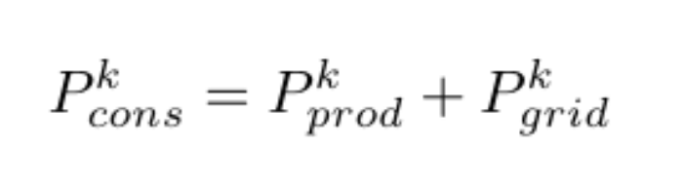

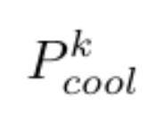

Power
Solar panels
Data center
Electricity grid
Notes:
Grid: when not enough production
Other consumption neglected

Slide 10
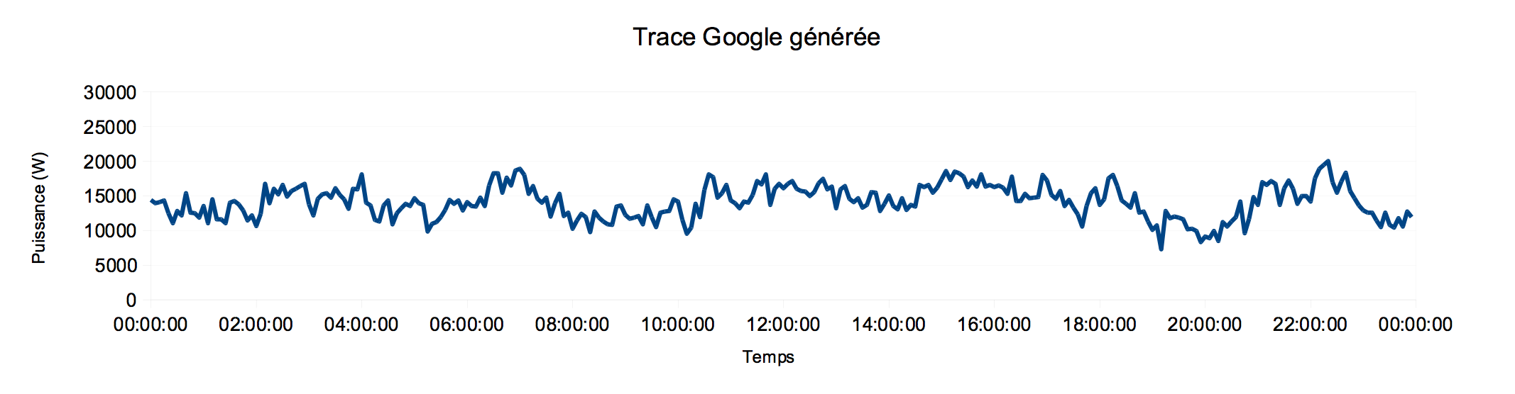
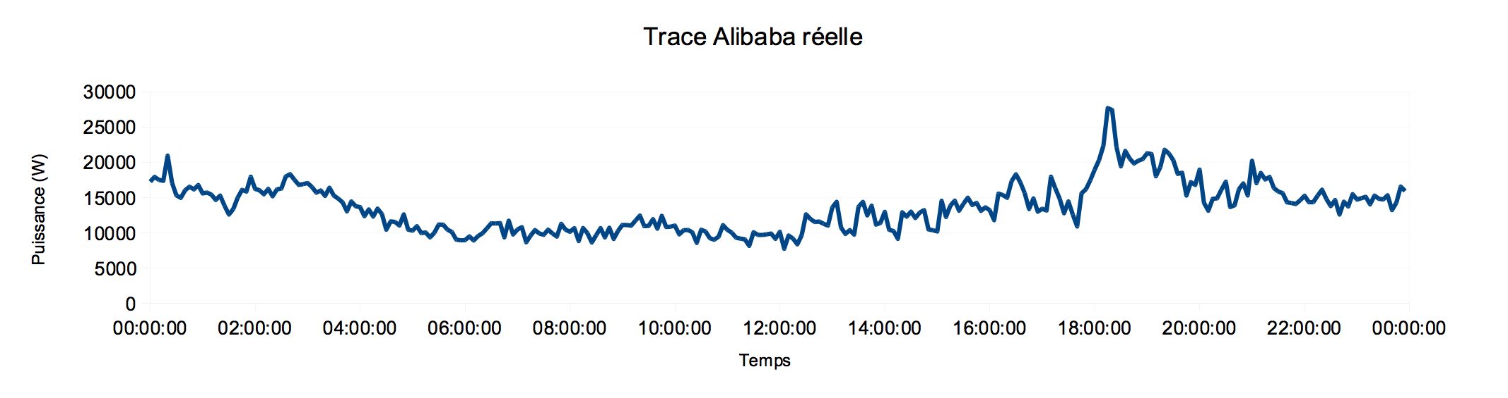
IT Workload
Generated Google trace
Real Alibaba trace
Notes:
Two different workloads:
Generator from lieterature
Real trace from an Alibaba DC madeopenly available
that we have normalized to have an average of 14 kW

Slide 11
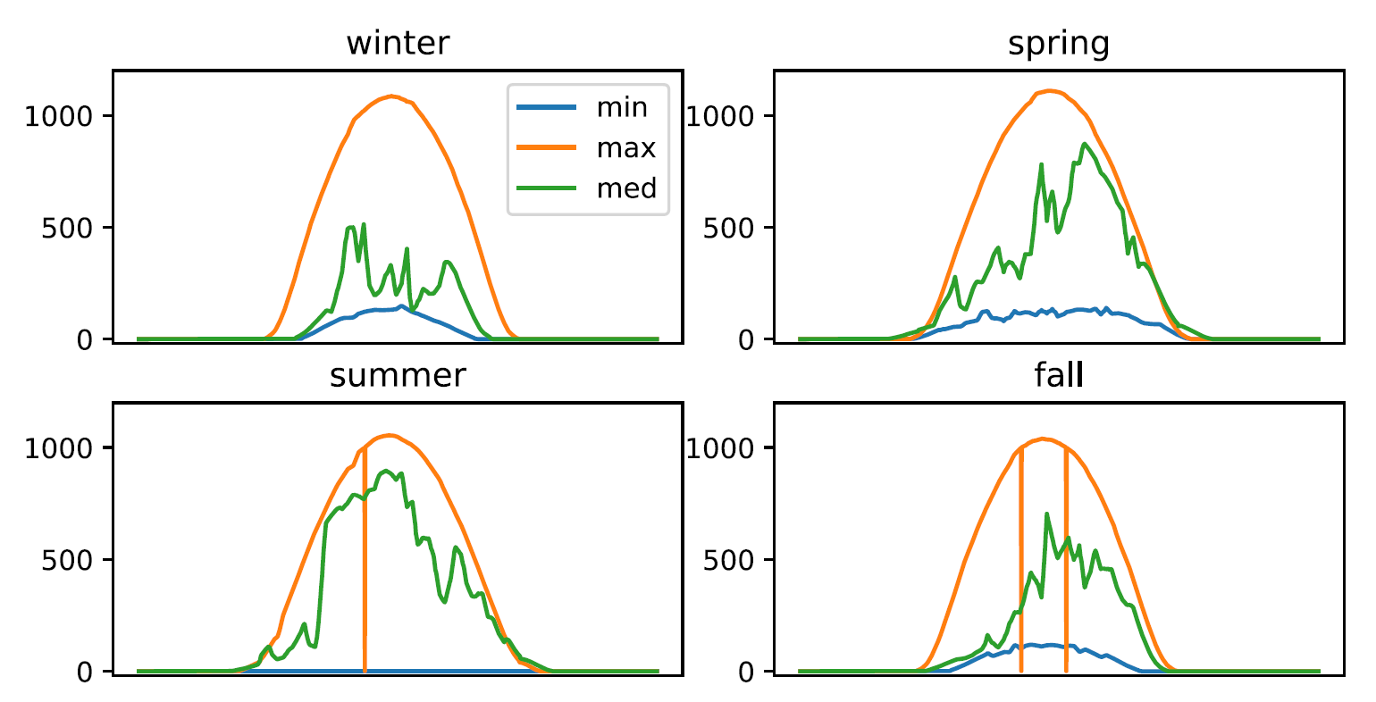
Solar production and weather
Minimal, median and maximal days of solar irradiation (W/m²)
Notes:
Precise irradiation data + ambient temp
Belfort, France, 2006

Slide 12
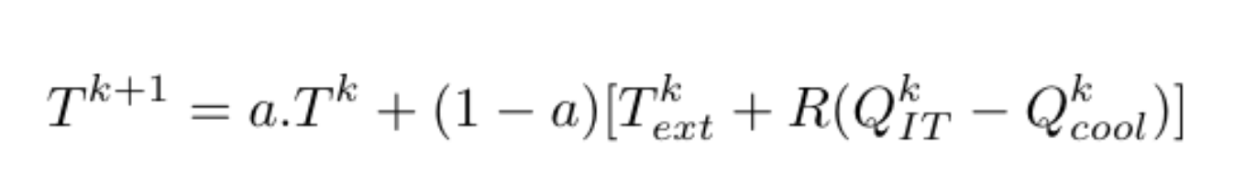
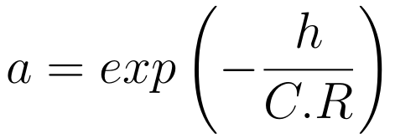
Thermal model
Temperature evolution
Thermal inertia
Heat generated
by IT
Thermal
transfers
w/ outside
Heat dissipated by
the heat pump
Notes:
Discreate thermal model and constants taken from Lukawski et al., study about peak loads.
Temperature at time k+1 influenced by 4 quantities at time k
Q = heat approximated by P

Slide 13
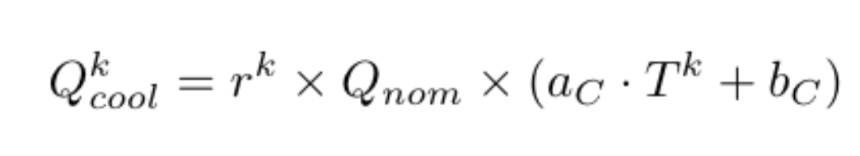
Cooling
Geothermal heat pump
r^{k} ∈ {0,1,2}
Three states for thermostatic control
Notes:
Cooling device: heat pump with 3 states: off, nominal or double capacity
Linear dependency on room temp

Slide 14

Numerical simulation
Step-by-step simulation
Inputs:
Time frame (24h)
Time step (5min)
IT workload
Solar data
Temperature data
Notes:
To investigate potential of pre-cooling, we simulated the building blocks of the theoretical model in Python.
I will show typical outputs of our simulation

Slide 15
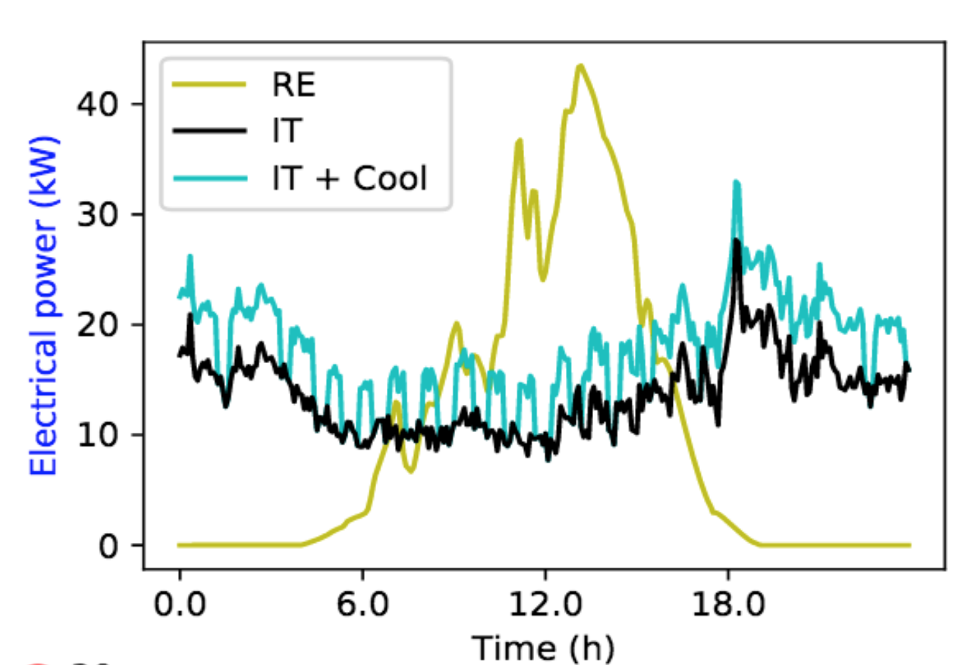
Without optimisation, thermostatic control
Algorithm:
When the temperature reaches a certain threshold, switch on the cooling (state 1)
Switch off when the temperature drops below another threshold.
Notes:
Explain outputs and algo.
Potential of pre-cooling stands in this time window: cool more to lower temp and be able to switch off.

Slide 16
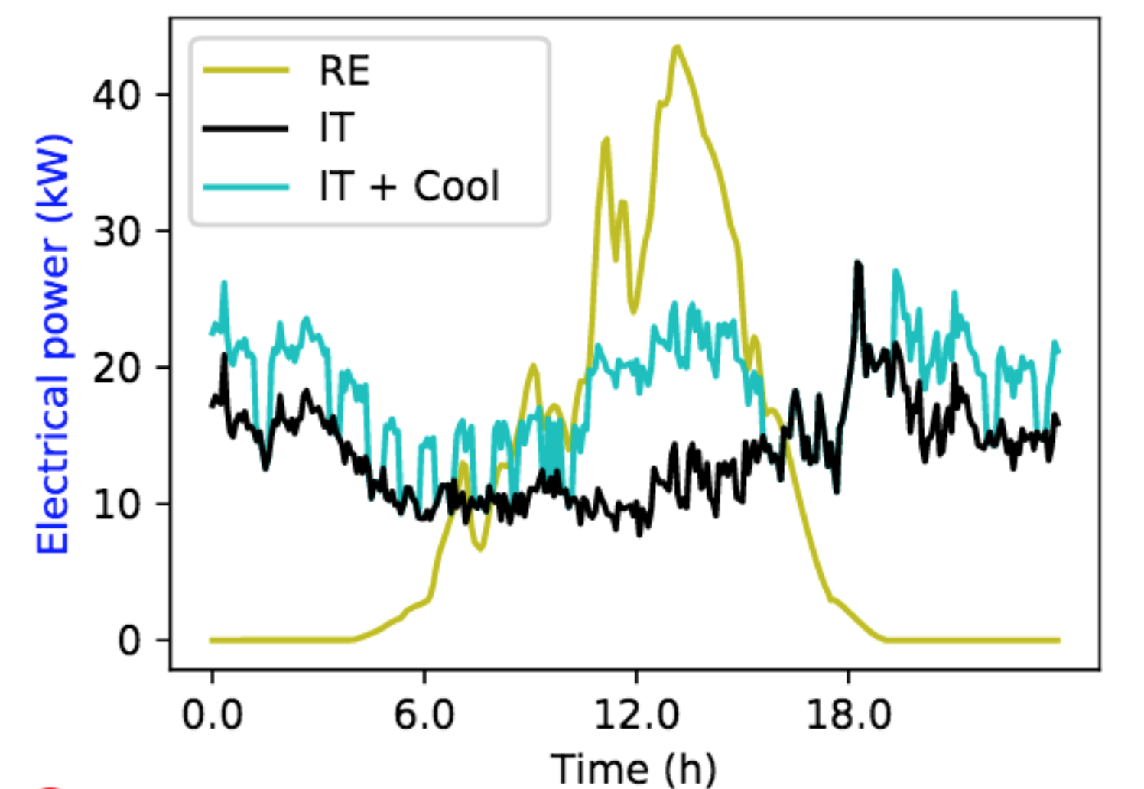
Naive optimization
Algorithm:
Use the cooling at maximum state (state 1 or state 2, depending on available power) when renewable energies exceeds IT consumption
Notes:
Cool were it fits
We were able to cut cooling a couple of hours in the evening.

Slide 17
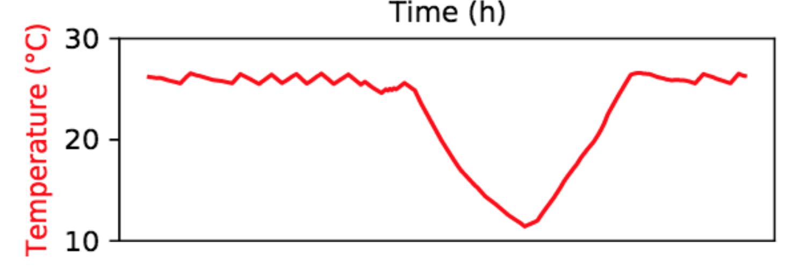

Naive optimization
Drawbacks:
Too ”greedy” management: overuse of renewables
Temperature drops below ASHRAE recommanded temperatures
When should we start pre-cooling?
Notes:
Two problems:
Obviously too Greedy: I doubt that this is better for the environment...
Overcooling under ASHRAE reco
When to start? Investigate this question by putting model into linear equations and solving with linear solver

Slide 18
Linear optimization
Variable to optimize
Solar panels
Data center
Electricity grid
Notes:
Stylo: fixed and variables
What do we want to optimize?
-> introduced prices. BUY grid and SELL solar

Slide 19
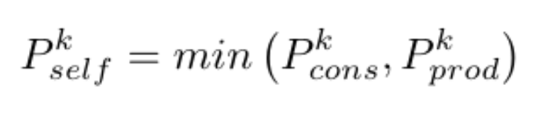
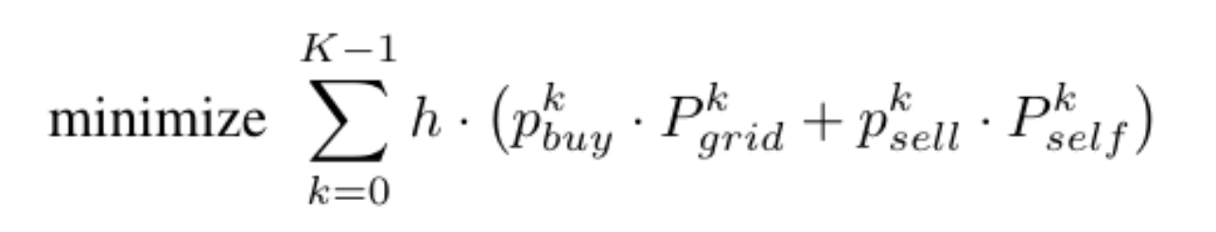
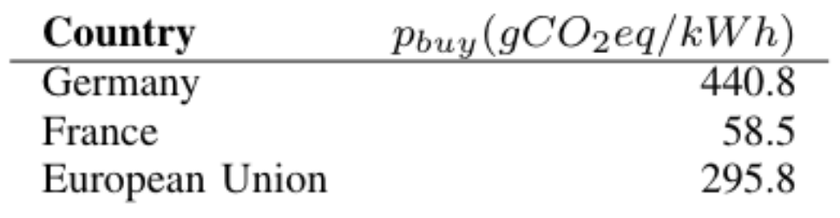
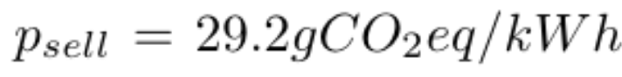
Linear optimization
Objective function:
Notes:
P_sell = LCA figure for solar energy. NOT free.
P_prod: pre-determined
P_cons is the variable
Sum over all the time steps = energy bill at the end of the day

Slide 20
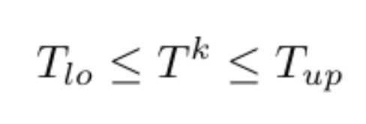
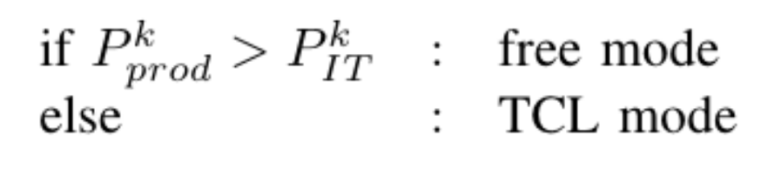
Linear optimization
Constraints:
Temperature evolution
ASHRAE thermal recommendations
Cooling system
Linear Solving with Gurobi
Simple Thermostatic Control (constraints not described here)
Notes:
Surplus production: linear opti
Else: managed to force TCL with set of constraints… not described

Slide 21
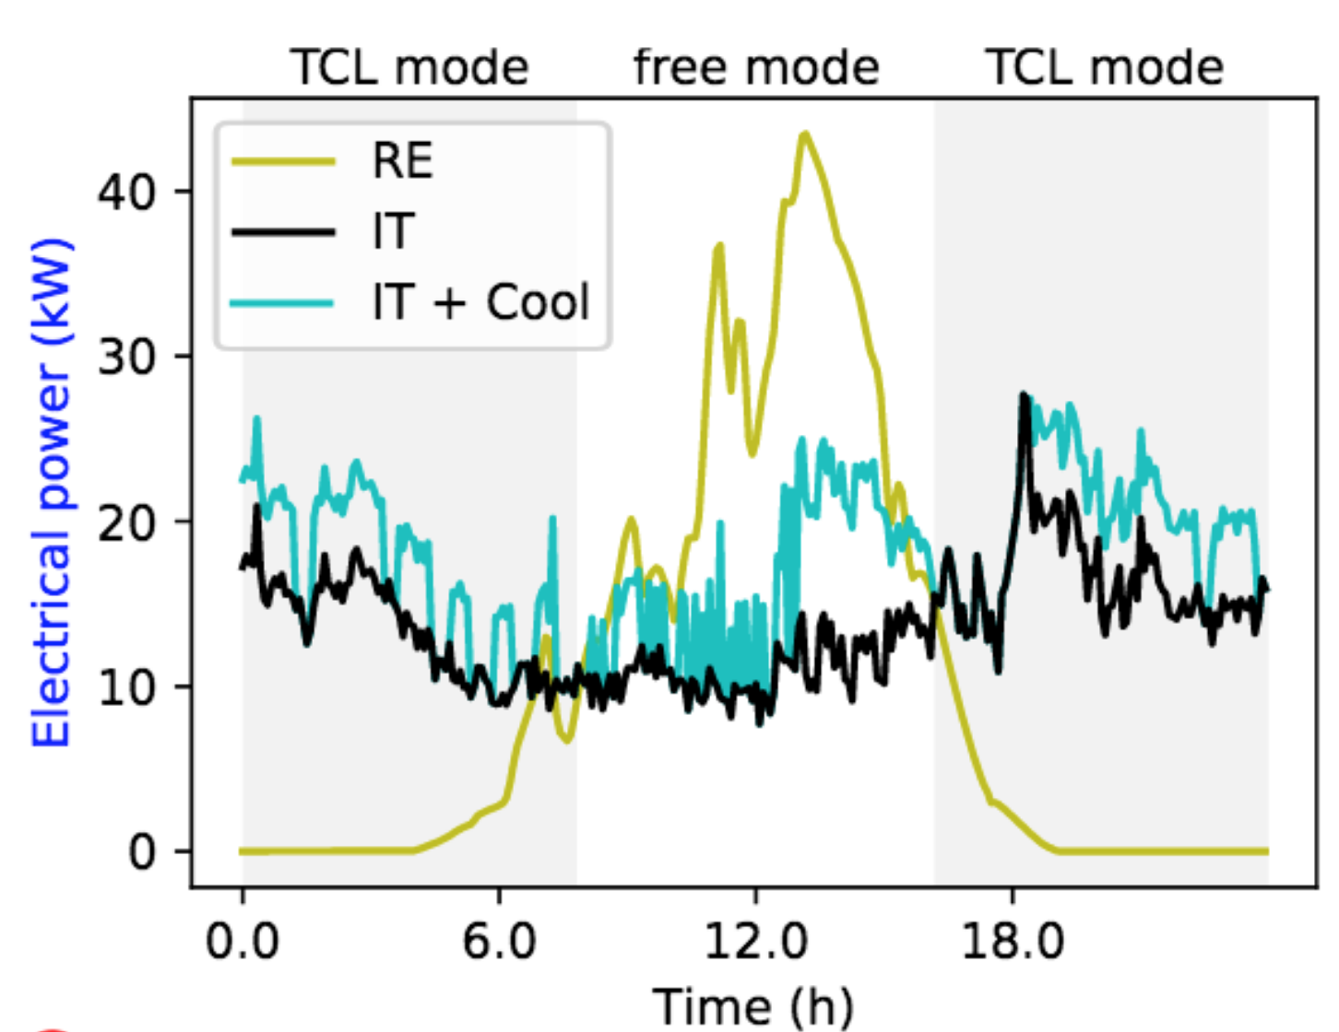
Output linear optimization
Notes:
Grayed area: don’t need opti (+ unrealistic and takes time).
Middle: cooling decided by gurobi

Slide 22
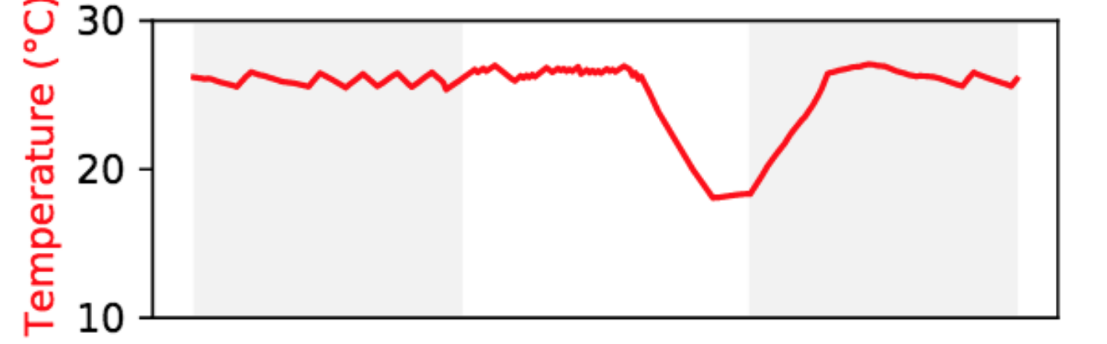
Output linear optimization
Notes:
And it demonstrates that precooling in our model is the cooling managt that minimize the carbon footprint of our DC

Slide 23
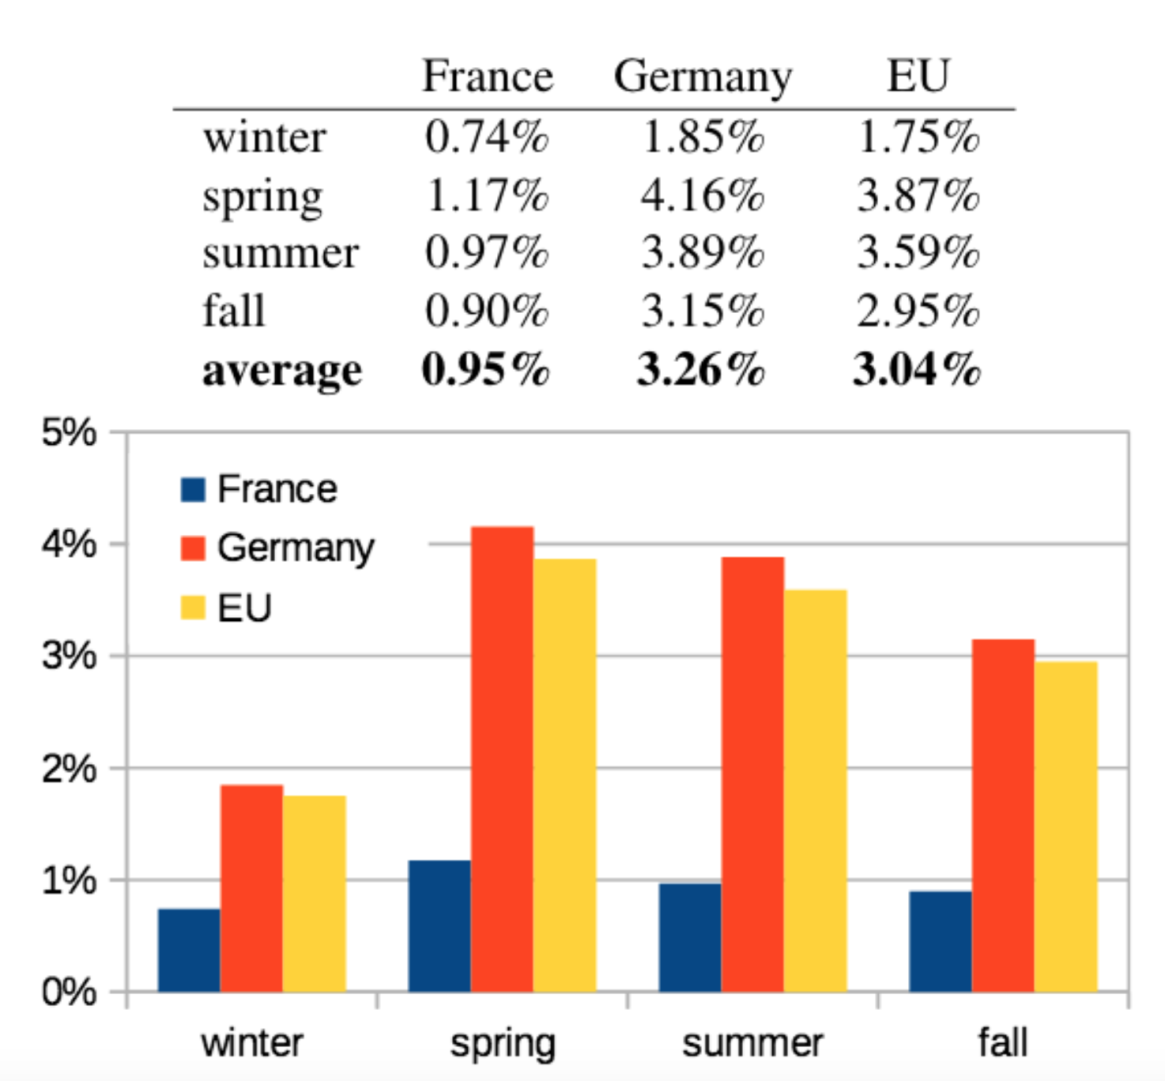
Expected CO2 savings
Simulations on median production day of each season
Exploratory results: potential of pre cooling
Notes:
Germany: more carbonizedelec mix -> incentive for precooling
Exploratory: insight on the potential
-> if we want to compare to other CO2 reducing mesures

Slide 24
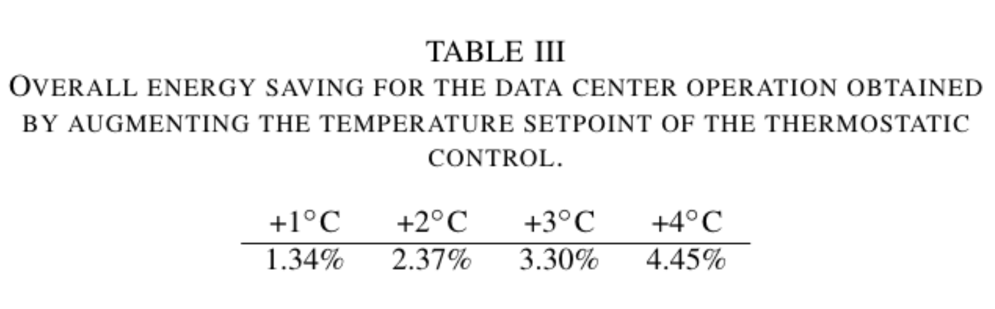
Comparing with increasing temperature set points
Notes:
Just being able to switch off the cooling 1 or 2 hours everyday made acheive same as +1 or +3 deg

Slide 25
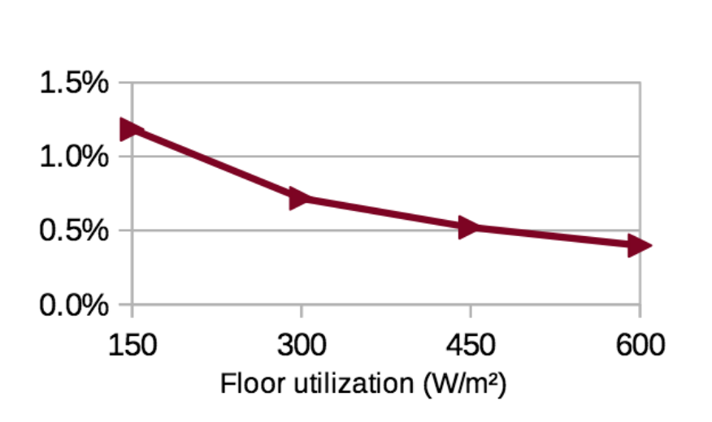
Server density influence
Highest IT density leads to lower savings, because the heat production is higher and the cooling must run more at full state
Notes:
Remember: we said at the beginning that more potential for low density
Impact of the density of servers: our is around 150W/m2 -> large thermal intertia

Slide 26
Limits and future work
Limits:
Need for precise weather forcast data
Gurobi solving time consuming, not adapted for real-time management
Limited to small, low density data centers without thermal optimization
Future work:
Compare with different weather situations
Compare other electricity mixes, including wind and energy storage
Compare with other cooling systems (CRAC, free cooling…)
More precise thermal model (CFD, TRNSys)
Integrating in Datazero project
Notes:
Reaching the end of the presentation: let me enumerate the main limits of our study and the way forward.
Used precise weather that was RECORDED. For real time = need forcast. Affect results: everything played in 1 or 2 hours

Slide 27
Conclusion
Pre-cooling = small niche for optimization
CO2 emissions
Off-grid data centers
Holistic approaches more interesting
Energy storage
Integrated with task scheduling
Geographical load shifting
Rebound effect: “an efficiency strategy must always be accompanied by a sufficiency strategy” (Hilty, 2011)
Notes:
To conclude, we see precooling as a small niche of opti, an adjustment variable that can help minimizing carbon footprint of DC and contributes to self supplied DC
On a more reserved note, I would like to end my presentation by reminding to stay careful with this kind of optimization work and staying aware that rebound effects most of the time overcompensate the efficiency gains. Sufficiency strategies should be though through to expect a real overall gain.
Thank you for listening, feel free to email us if any questions.

Slide 28
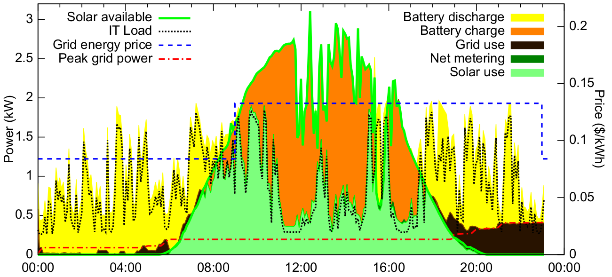
Self-consumption
Goiri et al. : Parasol et GreenSwitch
Notes:
Non optimized (or non defferable) IT
I will present similar kind of outputs for our work.

Slide 29
RESULTATS – influence des paramètres
Paramètres thermiques R et C
C = 0,046 ∈ [0,015 ; 0,065] kWh/°C/m²
1/R = 0,0019 ∈ [0,001 ; 0,003] kW/°C/m²
Pricing / intensité carbone
Autres contrats
Autres mix énergétiques

